Slide 1
Secure Modem
Hardware Design – The Vocoder

Slide 2
Contents
Vocoder Overview
Vocoder in Radio Modem
AMBE Vocoder
Summary
Discussion

Slide 3
Vocoder Overview
What is Vocoder
History of Vocoder
How Vocoder Works
Vocoder Application

Slide 4
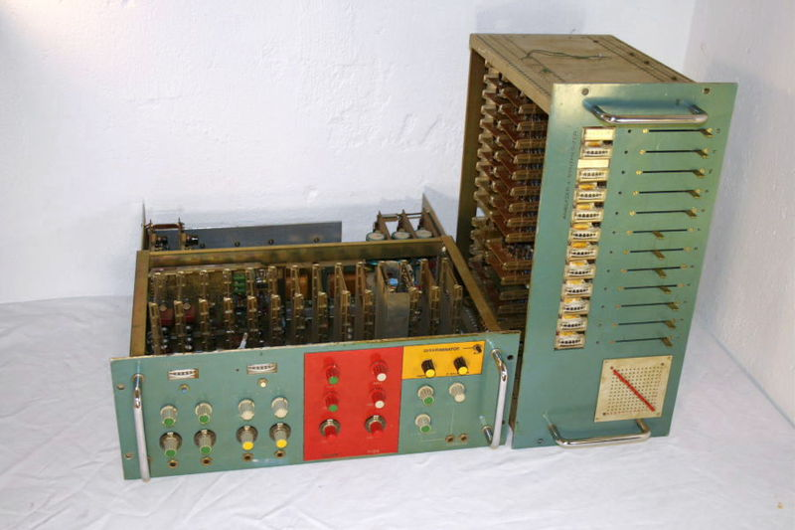
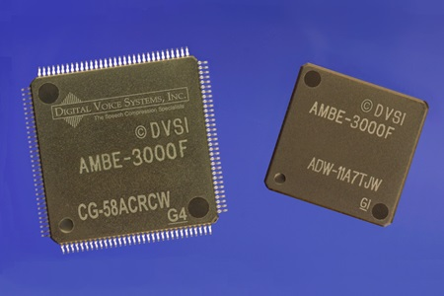
Vocoder Description
Early 1970s electronic music vocoder
The vocoder is an electronic device that analyzes the human voice, breaking it up into its component parts
The voder is a similar device that synthesizes a human voice
More often than not, vocoder and voder are combined in one unit
Vocoder chips
Notes:
Source:
http://www.ieeeghn.org/wiki/index.php/Vocoders_and_Voders

Slide 5
History of Vocoder
Motivation:
Bandwidth restrictions for transmission of a complete human speech
Potential for undesirable eavesdropping in traditional analog devices
In response to those issues:
Homer W. Dudley devised a system for vocal communication while working at Bell Labs
Described in detail in his 1935 patent application was the device known as the vocoder
Notes:
Notes:
Human freq. 80 Hz to 14 kHz but telephone call freq. only 340 Hz to 3.4 kHz
Source:
http://community.wvu.edu/~ndw010/projects/vocoder/
http://en.wikipedia.org/wiki/Wideband_audio

Slide 6
How Vocoder Works
Encoder
Speech waveform is passed through a parallel bank of BPF
After BPF, the filtered signal is passed to envelope follower to approximate the average amplitude of that band
BPF and envelope follower produce a rough frequency spectrum of speech waveform
Fundamental detector detects instantaneous fundamental frequency of speech signal
All those signals are combined to produce an encoded speech waveform
Simplified block diagram of voice encoder
Notes:
Source:
http://community.wvu.edu/~ndw010/projects/vocoder/

Slide 7
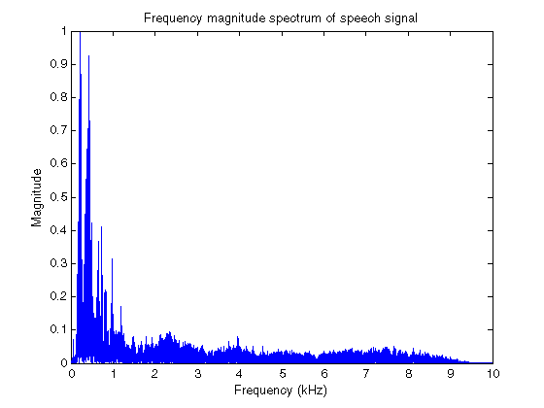
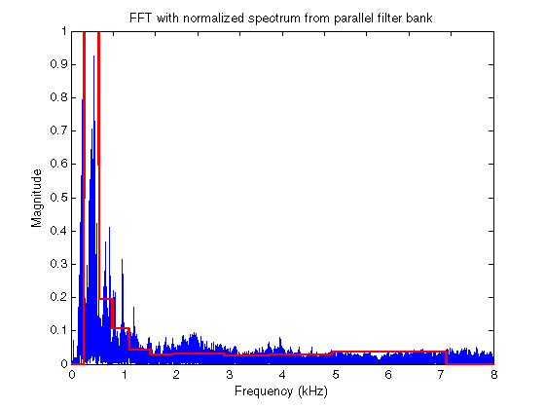
How Vocoder Works 1
Norm. freq. spectrum of a female speech signal
fs = 44.1kHz
Comparison of FFT spectra and filter output

Slide 8
How Vocoder Works 2
Decoder
The incoming signal is demultiplexed and each signal is routed to the appropriate block
Signal representing fundamental freq. is routed to VCO, which generates a waveform at fundamental freq.
This waveform then mixed with white noise signal and passed to BPFs
Simplified block diagram of voice decoder
Notes:
Notes:
VCO (Voltage Controlled Oscillator)
Source:
http://community.wvu.edu/~ndw010/projects/vocoder/

Slide 9
How Vocoder Works 3
Decoder cont.
The incoming signal representing the band levels, each drive the gain of one of VCA at the output of each filter
Each of the outputs are then mixed together to produce resynthesized speech signal
Notes:
Notes:
VCA (Voltage Controlled Amplifier)

Slide 10


Vocoder Application
Digital voice scrambling and encryption
VoIP system
Artistic musical effect
Cochlear implants
Etc.

Slide 11
Vocoder in Radio Modem
Commercial Radio Modem
Vocoder

Slide 12
Commercial Radio Modem
AOR ARD9900
Digital data and voice over analog radio
Interfacing TX/RX (MIC and SP)
Using AMBE2020 vocoder
Radio Modem AOR ARD9900

Slide 13
The Vocoder
Vocoder on AOR ARD9900
Vocoder on AOR ARD9900
8KHz Sampling Voice
2400bps
+
1200bps FEC

Slide 14
AMBE Vocoder
AMBE2020 chip
AMBE3000 chip

Slide 15
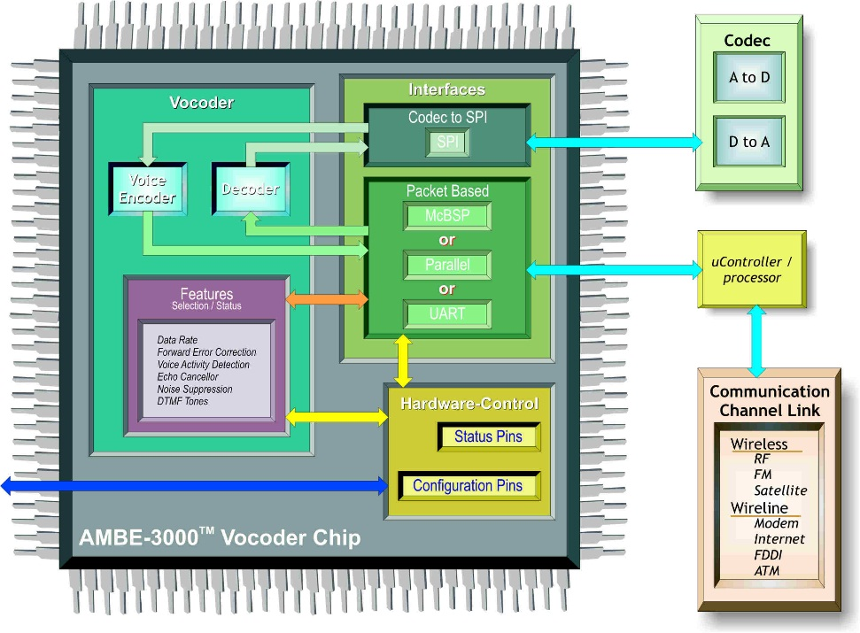
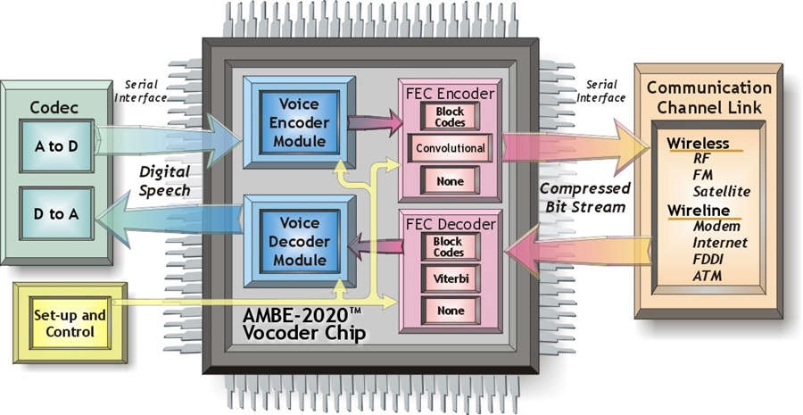
Comparison of AMBE Chips
AMBE3000 Layout
AMBE2020 Layout

Slide 16
Comparison of AMBE Chips 1
AMBE2020 specs:
Operation: Half-duplex
Data rates: 2.0 to 9.6 kbps
FEC rates: 50 to 7200 bps
AMBE+ compression
Interfaces:
Serial port for channel interface
Serial port for codec interface
AMBE3000 specs:
Operation: Half or Full-duplex
Data rates: 2.0 to 9.6 kbps
FEC rates: 50 to 7200 bps
AMBE+2 compression
Interfaces:
SPI (speech data samples interface only)
McBSP serial port
UART
Parallel port
Notes:
AMBE2020
Channel interface is general term for interface for compressed bits coming from encoder and going to decoder

Slide 17
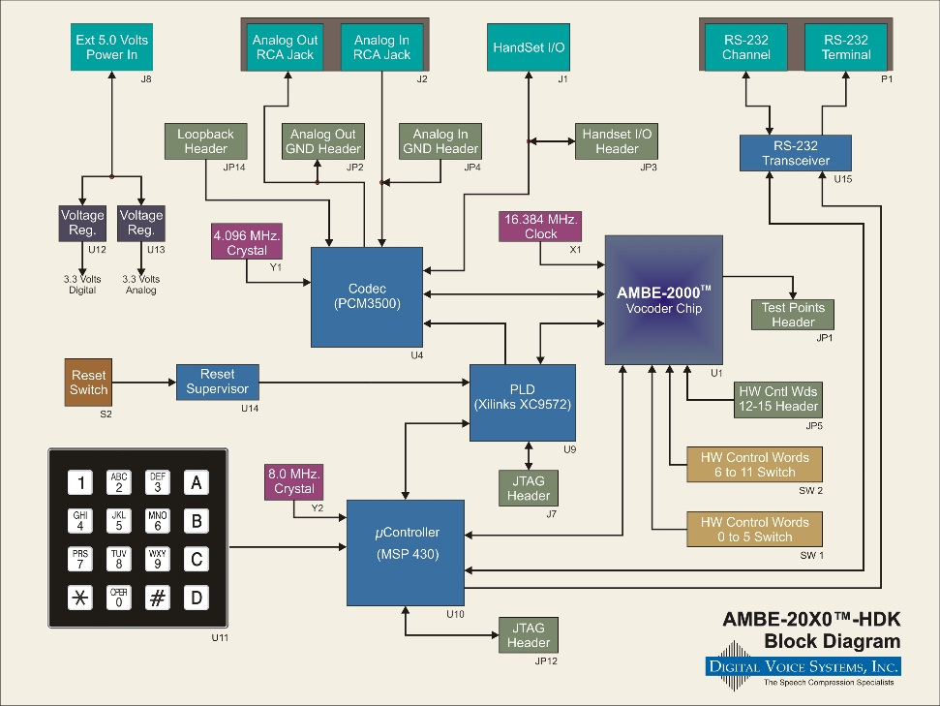
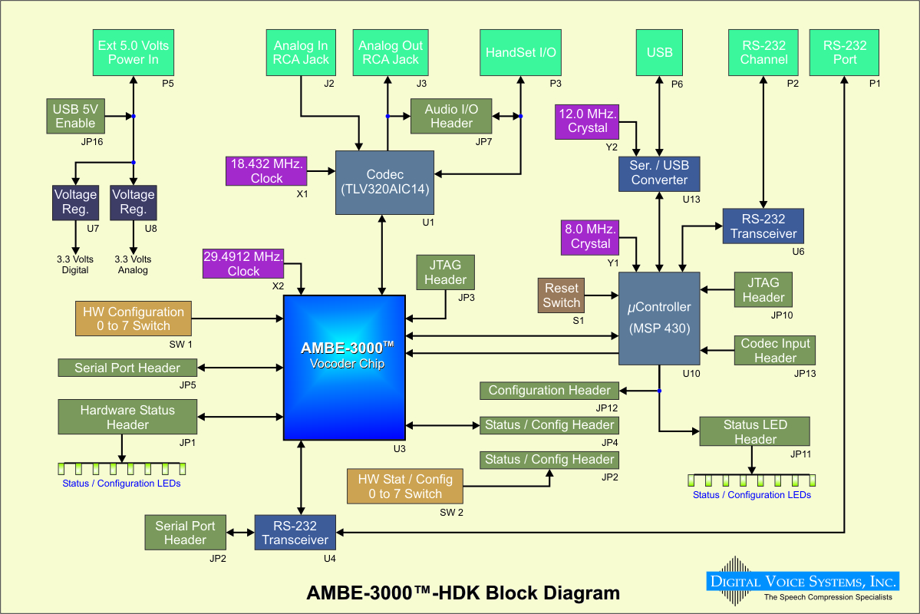
Comparison of AMBE Chips 2
AMBE2020 HDK Block Diagram
AMBE3000 HDK Block Diagram

Slide 18
Comparison of AMBE Chips 3
AMBE2020 HDK:
Vocoder
Audio Codec
Controller
Vocoder and Controller interface IC
AMBE3000 HDK:
Vocoder
Audio Codec
Controller

Slide 19
Summary

Slide 20
The Vocoder
Vocoder is a device that analyzes and synthesizes human voice
Main motivation of vocoder creation is bandwidth restriction for transmission of a complete human speech
Encoder and decoder process

Slide 21
The Vocoder 1
Comparison of AMBE chips (AMBE2020 and AMBE3000)
AMBE2020 | AMBE3000
Half-duplex | Half or full-duplex
Data rates: 2.0 – 9.6 kbps | Data rates: 2.0 – 9.6 kbps
FEC rates: 50 – 7200 kbps | FEC rates: 50 – 7200 kbps
AMBE+ compression | AMBE2+ compression
Interfaces: serial | Interfaces: serial and parallel
HDK: vocoder, audio codec, controller, and FPGA (vocoder and controller interface) | HDK: vocoder, audio codec, and controller

Slide 22
Discussion

